Slide 1
Chi-squared Test

Slide 2
Outline
What is a Chi-squared test
Chi-squared test example

Slide 3
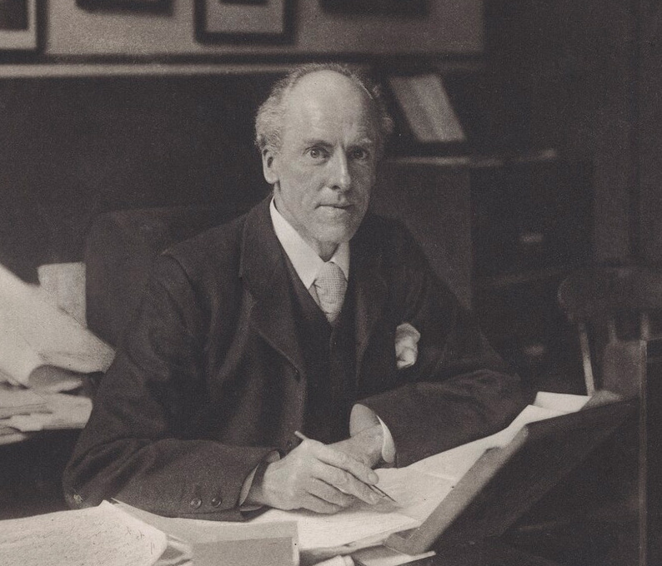
What is a Chi-squared test
The chi-squared is a statistical test that is used to determine whether there is a relationship between two categorical variables.
It is applied to sets of categorical data to evaluate how likely it is that any observed difference between the sets arose by chance.

Slide 4
Example: Littering Behavior Between Genders
Presume you observed 100 people to see who deposits garbage in the can and who litters. You want to see if there is a difference based on gender.
A person can fall in one of for categories
Person | Deposit | Litter | Male | Female
John | Yes | no | Yes | No
Julia | No | Yes | No | Yes

Slide 5
Example: Littering Behavior Between Genders
Given this data, is there a significant difference in littering behavior between men and women?
 | Deposit | Litter
Female | 18 | 7 | 25
Male | 42 | 33 | 75
 | 60 | 40 | 100

Slide 6

Example: Littering Behavior Between Genders
Null Hypothesis $H₀$:
Males and females litter at the same rate.
Alternative Hypothesis $H₁$:
Males and females litter at different rates.
 | Deposit | Litter
Female | 18 | 7 | 25
Male | 42 | 33 | 75
 | 60 | 40 | 100

Slide 7

Example: Littering Behavior Between Genders
To answer this question, you have to figure out what numbers you might expect if everything were left to chance.
If $H_{o}$were true, that there is no difference based on gender.
 | Deposit | Litter
Female | 18 | 7 | 25
Male | 42 | 33 | 75
 | 60 | 40 | 100

Slide 8
Example: Littering Behavior Between Genders
Since 60 people deposited their garbage and 25% of them were female, you would expect 15 (25% of 60) females to be the value in the upper left cell, if there’s an equal distribution – no effect on gender.
 | Deposit | Litter
Female | 18 15 | 7 | 25
Male | 42 | 33 | 75
 | 60 | 40 | 100

Slide 9
Example: Littering Behavior Between Genders
Since 40 people littered and 75% of them were male, you would expect 30 (25% of 60) males to be the value in the lower right cell, if there is no gender effect.
 | Deposit | Litter
Female | 18 15 | 7 | 25
Male | 42 | 33 | 75
 | 60 | 40 | 100

Slide 10
Example: Littering Behavior Between Genders
Since 40 people littered and 75% of them were male, you would expect 30 (25% of 60) males to be the value in the lower right cell, if there is no gender effect.
 | Deposit | Litter
Female | 18 15 | 7 | 25
Male | 42 | 33 30 | 75
 | 60 | 40 | 100

Slide 11
Example: Littering Behavior Between Genders
Working in a similar method, you can fill in all the expected values.
The further the observed values are from the expected values, the more likely that there really is a significant difference.
 | Deposit | Litter
Female | 18 15 | 7 10 | 25
Male | 42 45 | 33 30 | 75
 | 60 | 40 | 100

Slide 12
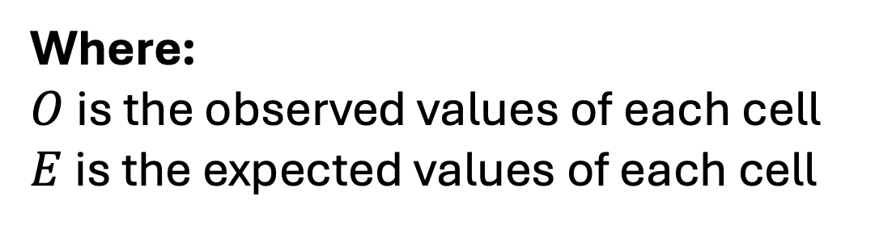
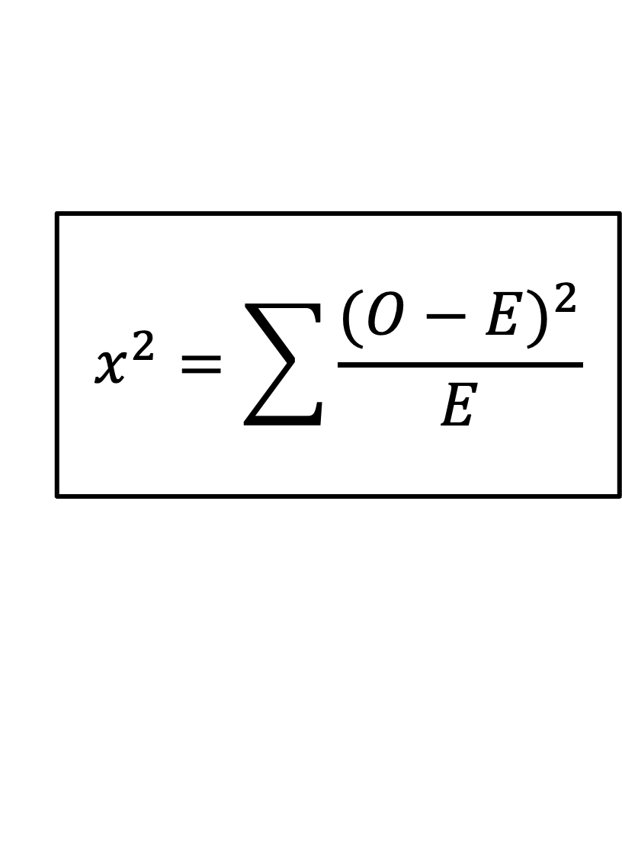
Chi-squared equation
$$x^{2}=\sum{\frac{{(O−E)}^{2}}{E}}$$
Where:
$O$ is the observed values of each cell
$E$ is the expected values of each cell

Slide 13
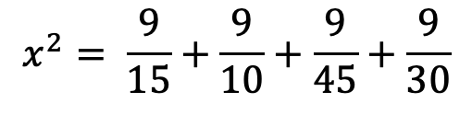
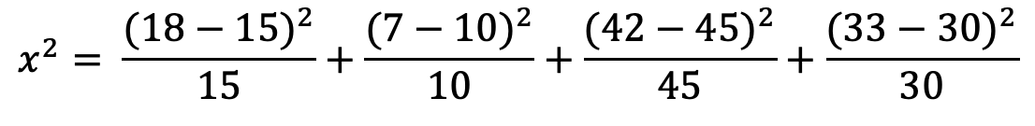


Chi-squared Test
 | Deposit | Litter
Female | 18 15 | 7 10 | 25
Male | 42 45 | 33 30 | 75
 | 60 | 40 | 100
$$x^{2}= \frac{{(18−15)}^{2}}{15}+\frac{{(7−10)}^{2}}{10}+\frac{{(42−45)}^{2}}{45}+\frac{{(33−30)}^{2}}{30}$$
$$x^{2}= \frac{9}{15}+\frac{9}{10}+\frac{9}{45}+\frac{9}{30}$$
$$x^{2}=0.6+0.9+0.2+0.3$$
$$x^{2}=2.0$$

Slide 14




Chi-squared Test: Degree of Freedom and Significance Level
$$x^{2}=2.0$$
$$df=\left(number of rows −1\right) (number of columns−1)$$
$$df=\left(2−1\right) \left(2−1\right)$$
$$df=1$$
$$significance level σ=0.05$$

Slide 18
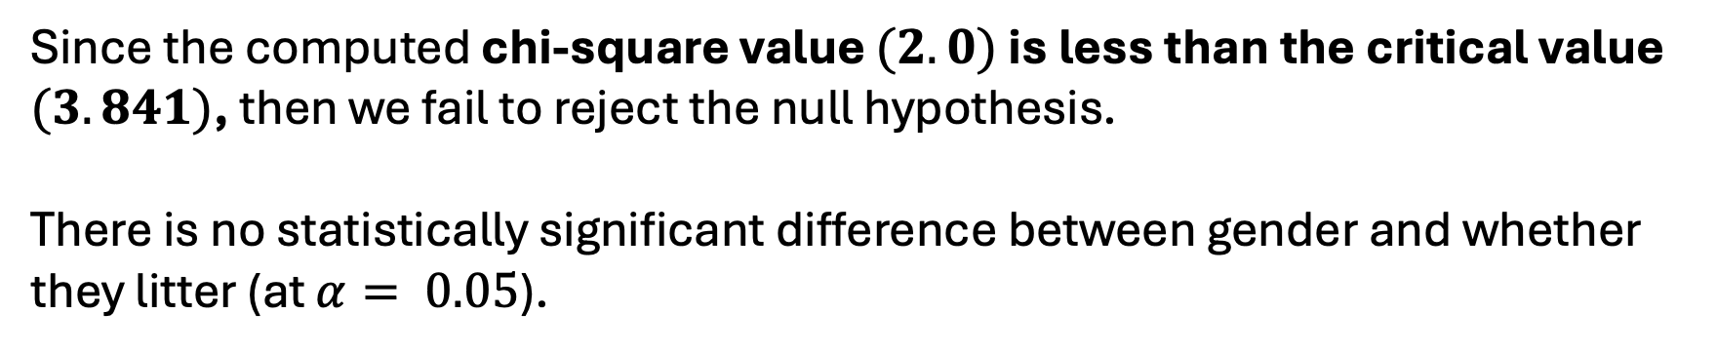
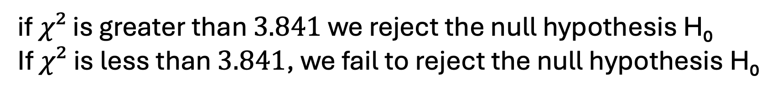
Chi-squared test: Decision
if $χ²$ is greater than $3.841$ we reject the null hypothesis H₀
If $χ²$ is less than $3.841$, we fail to reject the null hypothesis H₀
Since the computed chi-square value $(2.0)$ is less than the critical value $(3.841)$, then we fail to reject the null hypothesis.
There is no statistically significant difference between gender and whether they litter (at $α= 0.05$).

